Slide 1

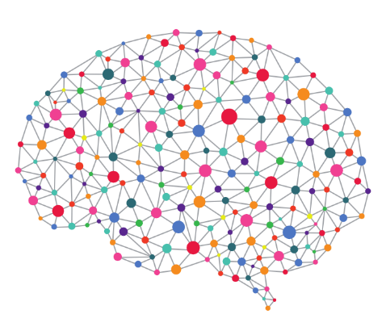
Western Power Hack-a-Gig
Team UnicorNN

Slide 2
Challenge 1 – Smart Meter Data
Overview
Approach
Results
Insights

Slide 3
Overview
To do

Slide 4
Challenge 2
Photovoltaic generation
PART A - Detection

Slide 5
Overview
1
Retrieve Data
2
3
Explore Data
Prepare Data
4
Develop model
5
Assess performance
6
Submit Model
Define requirements
Understand task
Analyse data
Form an approach
Consider limitations
Determine deliverables
Follow to-do list (right)
Document learnings
Share insights

Slide 6
Requirements (Part A)
The task
Utilise Western Power data to develop a model which identifies distribution embedded PV generation. Target a model accuracy of >98.5%.
Test what works, what doesn’t work – document learnings
Assess model performance against a hold-out set
Provide required documents

Slide 7
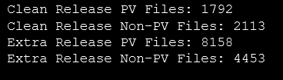
Approach
Understand Data
What is provided?
Clean Release
High degree of assumed PV and Non-PV image labelling accuracy
Smaller set
Extra Release
Lower degree of confidence in labelling accuracy
Larger set (2-4x)

Slide 8
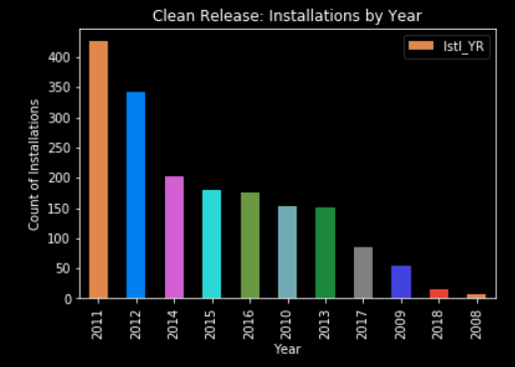
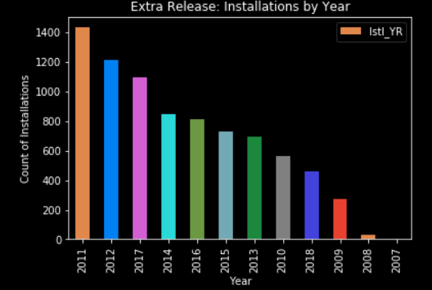
Approach
Majority of installation images from 2011/2012
Range of installation years begins in 2007
Installation data prior to 2007 may be missing or limited in WP databases
Understand Data
What does it tell us?

Slide 9
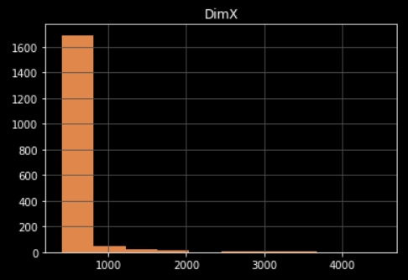
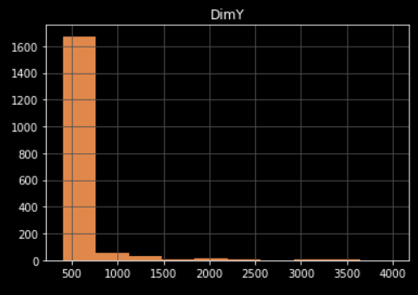
Approach
Most images are 400px x 400px (square). Useful for batch normalisation.
Larger images up to 6000px are likely to create issues when resized to the model’s standard resolutions of 224px or 299px (square).
Not all images are square (n px by n px). May require segmentation and to be placed into a subset (not implemented in model).
Images are assumed to all be top-down aerial imagery, however it is noted that not all images are taken from the same height. This is particularly visible in images that are not the standard 400x400px resolution.
Understand Data
How does it look?

Slide 10
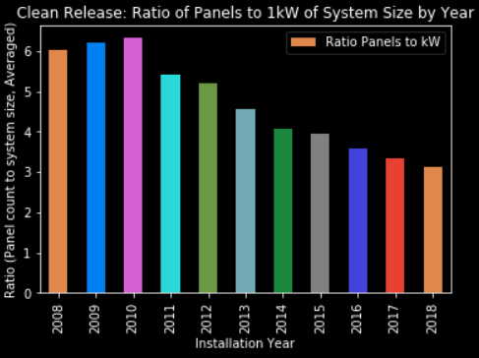
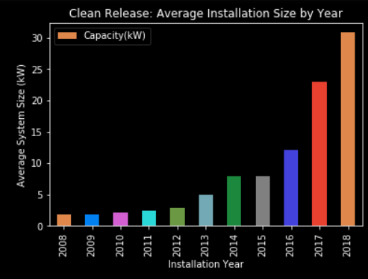
Approach
Exponential system size increase based on annualised data
Increased system sizes partly attributable to panel efficiency gains (W/m²)
Understand Data
And have a bit of fun…

Slide 11
Approach
Consider limitations
What may create false positives?
Air-conditioning units | Vehicles | Drawn-out shadows
Pools | Pergolas | Roof-tie structures
Elevated roof sections | Solahart water-heating units | Commercial ducting
Commercial walkways | Parking spaces and driveways | Water tanks
Tarps | Trampolines
The provided data is binary (PV, Non-PV)
Binary data limits the model to a sigmoid final model layer

Slide 12
Approach
Consider limitations
What may create false negatives?
Rectangular images | Objects covering panels | Poorly angled panels

Slide 13
The Model
Convolutional Neural Net (CNN) model
Leverages the Fast.AI wrapper on top of PyTorch
Specifies:
Data set to utilise
Functions to split source data into a training & validation set
Functions to import image meta-data
Learning rate specification and annealing
Data augmentation
Result accuracy based on confusion matrix output

Slide 14
What worked? [First Run]
Resnet34 Architecture:
First run with a single training epoch: 86.4% accuracy
False negatives generally occur where panel edges are not visible
False positives generally occur on grid-like structures
Learning rate utilising SGDR on final layer provides small improvement: 88.6%
SGDR with differential learning rates yields significant accuracy increase
Tuning the 3rd last layer: Minimal accuracy improvement, model underfitting
Tuning the 2nd last layer: Small accuracy improvement, minor overfitting
Tuning the last layer: Significant accuracy improvement, overfitting (97.3%)
TTA provides small benefit: 97.8% accuracy

Slide 15
What worked?
Dropout
No dropout results in rapid overfitting – not recommended
Default dropout of 25% (first dropout layer) and 50% (second dropout layer) in the resnet34 model worked well

Slide 16
What didn’t work?
Significant dropout:
50% dropout resulted in 89.7% accuracy (↓8.1%)
25% dropout

Slide 17
Challenge 2
Photovoltaic generation
PART B - SIZING

Slide 18
Overview
Part B continues from Part A code
PV image Metadata is accessible in the Jupyter Notebook

Slide 19
Thank you for your attention.
Team UnicorNN
Sofia Sibanic
Adrian Goldberg
Sandesh Satpute
Jordan Pratt

